Slide 1
VSTEP B1/B2 – LESSON 7
WRITING
Tổng quan viết luận

Slide 2
01
TỔNG QUAN VIẾT LUẬN

Slide 3




TỔNG QUAN VỀ VIẾT LUẬN
Độ dài khoảng 250 từ
Không viết thiếu từ
Không nên viết trên 300 từ
Thời gian khoảng 40 phút
Nên dành 5 phút đọc đề và lập dàn ý
Nên dành 5 phút cuối giờ để soát lại lỗi
Chiếm 2/3 tổng điểm bài thi
Nên luyện viết nhiều để kiểm soát tốt thời gian
Nên bám sát template
https://edulife.com.vn/

Slide 4
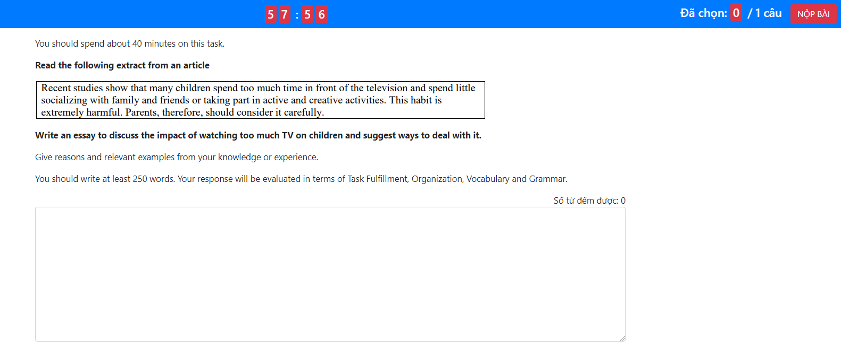
GIAO DIỆN THI TRÊN MÁY TÍNH
THỜI GIAN CÒN LẠI
CÂU HỎI
TIÊU CHÍ ĐÁNH GIÁ
VIẾT BÀI TẠI ĐÂY
https://edulife.com.vn/

Slide 5
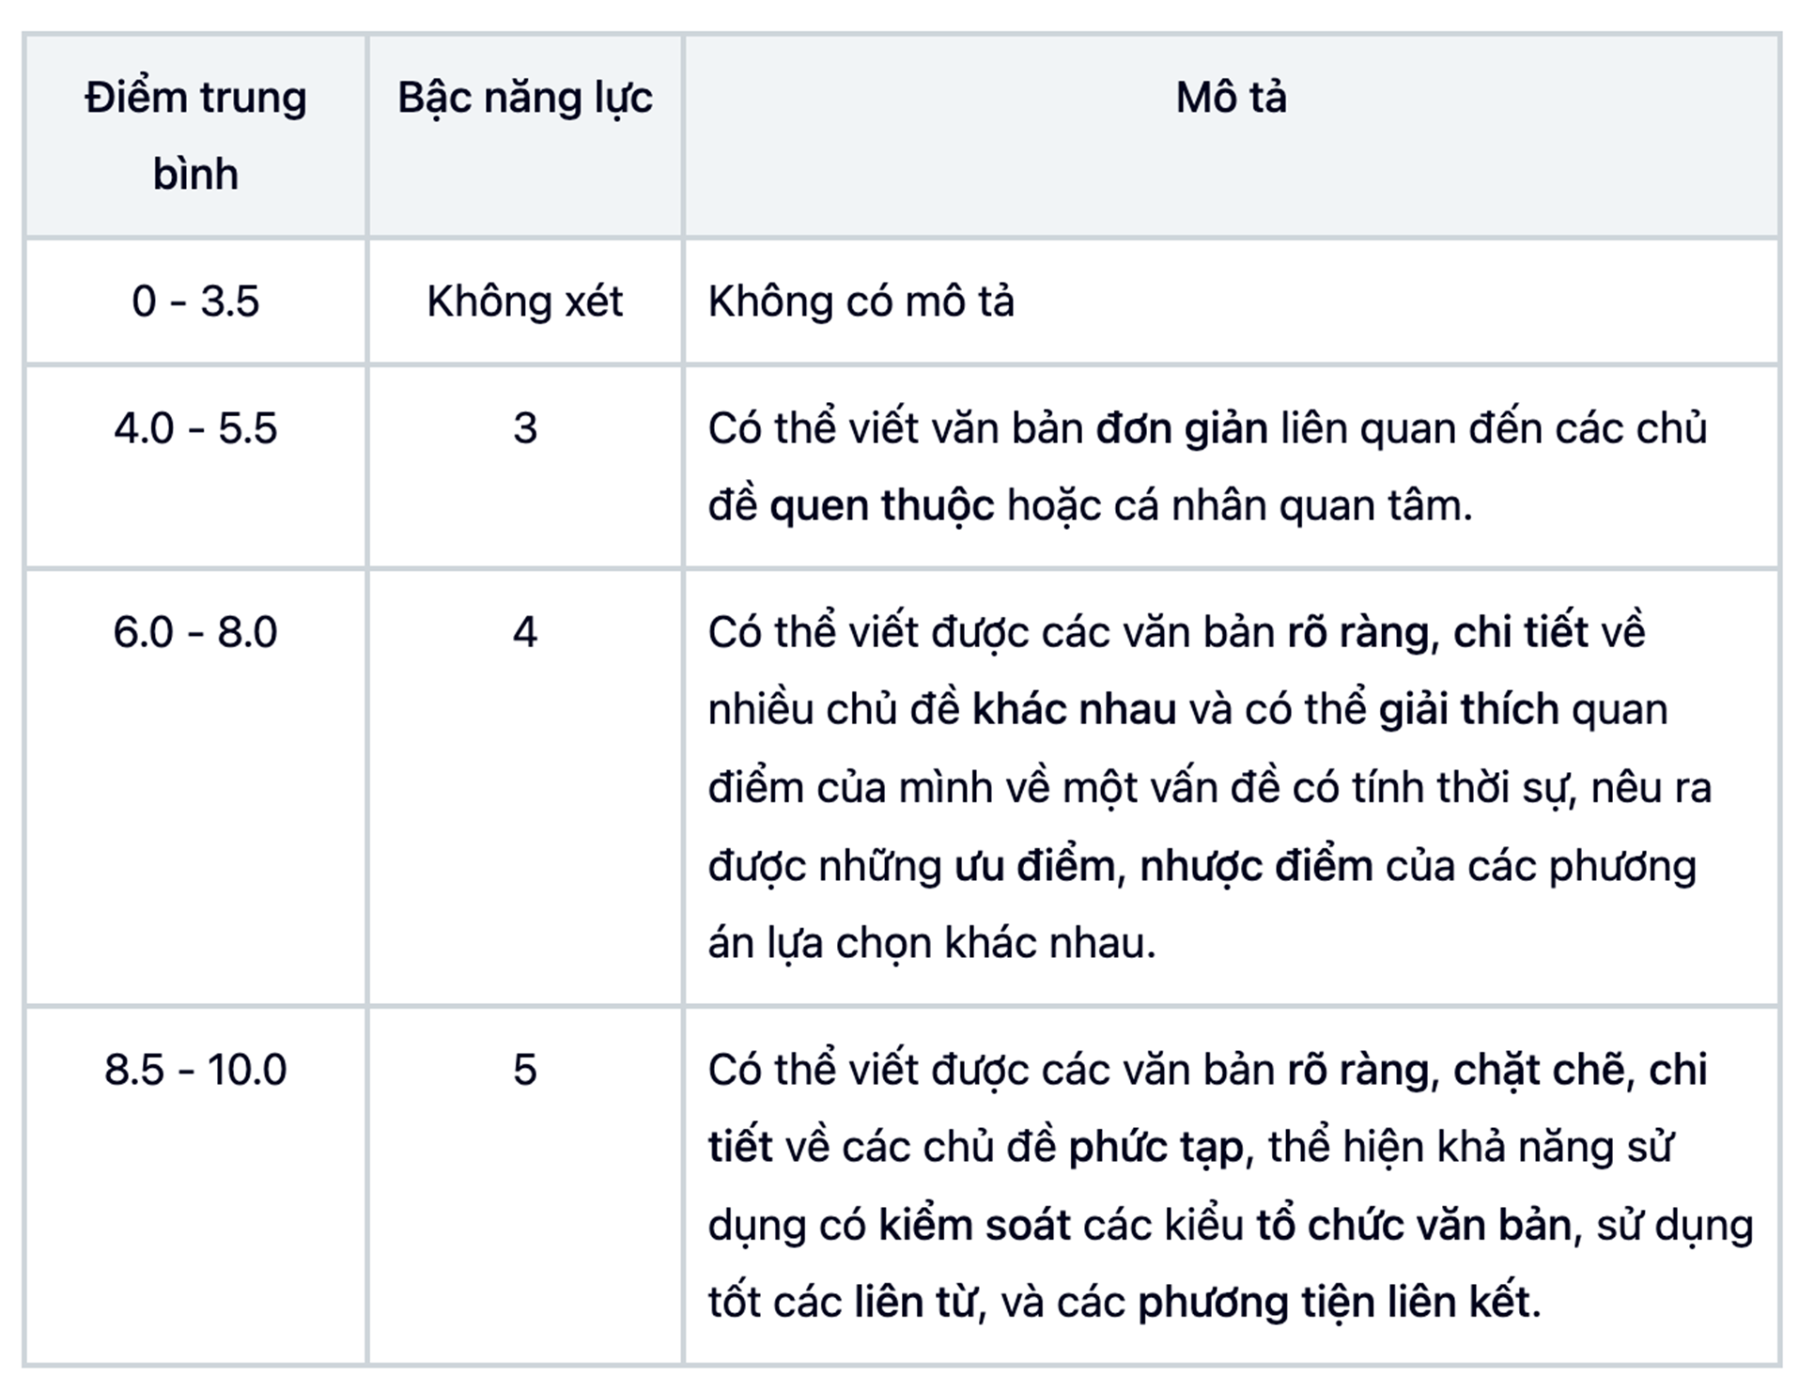
TIÊU CHÍ CHẤM ĐIỂM
(1) Đạt yêu cầu đề bài
(3) Từ vựng
(2) Tổ chức & Logic
(4) Ngữ pháp
+ (2) + (3) + (4)
Điểm Task 2
4
7 + 6 + 5 + 5
Ví dụ
5.75 (6)
4
Lưu ý: Các tiêu chí (1) (2) (3) (4) sẽ được tính theo điểm tròn từ 1-10, điểm Task 2 sẽ được làm tròn đến 0.5
Notes:
Giáo viên xem thêm tiêu chí chấm nói - viết tại đây

Slide 6
02
PHÂN LOẠI BÀI LUẬN

Slide 7
CÁC DẠNG BÀI LUẬN PHỔ BIẾN
1. Opinion (Agree or Disagree)/ Argumentative
(Dạng bài quan điểm - tranh luận)
2. Discussion Essay
(Dạng bài thảo luận)
3. Advantages and Disadvantages
(Dạng bài lợi ích- bất lợi)
4. Problem and Solution/ Cause and Solution/ Cause and Effect
(Dạng bài vấn đề -giải pháp; nguyên nhân - giải pháp; nguyên nhân - hệ quả)
5. Two-Part Questions (Direct questions)
(Dạng câu hỏi trực tiếp, có thể là nguyên nhân - hệ quả; nguyên nhân-giải pháp; xu hướng phát triển tiêu cực hay tích cực)
Notes:
Tổng hợp đề viết luận: Tại đây

Slide 8
CÁC DẠNG BÀI LUẬN PHỔ BIẾN
Bài luận sau thuộc loại nào?
You should spend about 40 minutes on this task.
Read the following text about public service.
Some people believe that unpaid community service should be a compulsory part of high school programs (for example working for a charity, improving the neighbourhood or teaching sports to younger children).
To what extent do you agree or disagree?
You should write at least 250 words. Your response will be evaluated in terms of Task Fulfilment, Organization, Vocabulary and Grammar.

Slide 9
CÁC DẠNG BÀI LUẬN PHỔ BIẾN
Bài luận sau thuộc loại nào?
You should spend about 40 minutes on this task.
Read the following text about public service.
Read the following text about smoking
Medical studies have shown that smoking not only leads to health problems for smokers, but also for people close by. For this reason, smoking should be banned in public places.
Opponents argue that banning smoking would possibly affect the freedom of choice or lead to the closure of many bars and pubs. However, supporters of this ban place people’s health problems at the top of the scale.
Write an essay to an educated reader to discuss your opinions about whether public smoking should be banned or not.
You should write at least 250 words. Your response will be evaluated in terms of Task Fulfilment, Organization, Vocabulary and Grammar.

Slide 10
CÁC DẠNG BÀI LUẬN PHỔ BIẾN
Bài luận sau thuộc loại nào?
You should spend about 40 minutes on this task.
Read the following text about public service.
Read the following text about social media
Nowadays children spend a lot of time using the media such as TV, the radio and the Internet. This has negative effects on children’s health and their performance at school. Others believe that the media prepare children for the real world.
To what extent should children be encouraged to use the media?
You should write at least 250 words. Your response will be evaluated in terms of Task Fulfilment, Organization, Vocabulary and Grammar.
Notes:
Direct questions

Slide 11
CÁC DẠNG BÀI LUẬN PHỔ BIẾN
Bài luận sau thuộc loại nào?
You should spend about 40 minutes on this task.
Read the following text about public service.
Read the following text about subjects
Some people believe that the subjects that children are taught in schools should be decided by central authorities because they can guarantee the standardisation of teaching. Others say that teachers, not politicians, should be responsible for this task as they can choose subjects based on students’ interests and abilities, which can promote learning.
Discuss both views and give your opinion.
You should write at least 250 words. Your response will be evaluated in terms of Task Fulfilment, Organization, Vocabulary and Grammar.
Notes:
Direct questions

Slide 12
CÁC DẠNG BÀI LUẬN PHỔ BIẾN
Bài luận sau thuộc loại nào?
You should spend about 40 minutes on this task.
Read the following text about public service.
Nowadays many people have access to computers on a wide basis and a large number of children play computer games.
What are the positive and negative impacts of playing computer games and what can be done to minimise the bad effects?
You should write at least 250 words. Your response will be evaluated in terms of Task Fulfilment, Organization, Vocabulary and Grammar.
Notes:
Direct questions

Slide 13
CÁC DẠNG BÀI LUẬN PHỔ BIẾN
Bài luận sau thuộc loại nào?
You should spend about 40 minutes on this task.
Read the following text about public service.
A lot of places in the world rely on tourism as a main source of income. Unfortunately, tourism can also be a source of problems if it is not well-managed.
What are the advantages and disadvantages of tourism in the modern world? Do you think that the benefits of tourism outweigh its drawbacks?
You should write at least 250 words. Your response will be evaluated in terms of Task Fulfilment, Organization, Vocabulary and Grammar.
Notes:
Direct questions

Slide 14
03
PHÂN TÍCH CẤU TRÚC ĐỀ BÀI LUẬN
& YÊU CẦU

Slide 15
CẤU TRÚC ĐỀ BÀI WRITING TASK 2
There are now millions of cars on the road in most big cities. Pollution from cars is the most important problem that big cities face today.
To what extent do you agree or disagree?
You should write at least 250 words. Your response will be evaluated in terms of Task fulfilment, Organization, Vocabulary and Grammar.
1. Topic to discussion:
pollution from cars on the road in big cities.
(Chủ đề: Ô nhiễm từ xe ô tô tại các thành phố lớn)
2. An argument you need to make your position clear on:
Whether or not pollution from cars
is the most important problem that big cities face today.
(Một lập luận mà bạn cần bày tỏ rõ quan điểm: Liệu rằng đây có phải là vấn đề quan trọng nhất mà các thành phố lớn phải đối mặt trong hiện tại hay không?)

Slide 16
YÊU CẦU
1. Viết đủ số lượng từ (không dưới 250 từ)
2. Có đầy đủ Mở bài - Thân bài - Kết bài
3. Viết đúng - đủ yêu cầu của câu hỏi, không thừa hoặc thiếu ý
4. Diễn đạt rõ ràng, mạch lạc, dễ hiểu

Slide 17
04
CÁC BƯỚC LÀM BÀI

Slide 18

VÍ DỤ
You should spend about 40 minutes on this task.
Being a celebrity - such as a famous film star or sports personality - brings problems as well as benefits.
Do you think that being a celebrity brings more benefits or more problems?
You should write at least 250 words. Your response will be evaluated in terms of Task fulfilment, Organization, Vocabulary and Grammar
Các bước làm bài:
Bước 1
Bước 2
Bước 3
Bước 4
Hiểu & xác định được yêu cầu của đề bài
Brainstorm &
lên outline
Viết bài
Kiểm tra lại & soát lỗi
Thời gian dự kiến:
1-2 phút
7-8 phút
18-20 phút
5-7 phút

Slide 19
BƯỚC 1: XÁC ĐỊNH YÊU CẦU ĐỀ BÀI
Being a celebrity - such as a famous film star or sports personality - brings problems as well as benefits.
Do you think that being a celebrity brings more benefits or more problems?
Chủ đề (general topic): |  |  | Themes
Chủ đề cụ thể (specific topic):
Câu hỏi cần trả lời:
Quan điểm của mình:
Side A (Body paragraph 1): |  | Side B (Body paragraph 2):
Famous people/ fame
Being a celebrity bring both benefits and problems
money
Does being a celebrity have more benefits or problems?
life/living
I think there are more problems
work
Benefits of being a celebrity
Problems with being a celebrity
Notes:
slide này sửa thành insert từ để tương tác với lớp dễ hơn

Slide 20
BƯỚC 2: BRAINSTORM & OUTLINE BÀI VIẾT
Being a celebrity - such as a famous film star or sports personality - brings problems as well as benefits.
Do you think that being a celebrity brings more benefits or more problems?
1. Điều đầu tiên bạn nghĩ đến khi nói về người nổi tiếng là gì?
2. Người nổi tiếng sẽ có những lợi ích gì và phải đối mặt với những vấn đề gì?
3. Tưởng tượng bạn là một người nổi tiếng - bạn thấy điều này nghe có hấp dẫn không? Điều đó có làm bạn hạnh phúc, vui vẻ không? Tại sao/tại sao không?
Nếu bạn nổi tiếng, cuộc sống của bạn sẽ như thế nào?
Bạn sẽ thích điều gì? Bạn không thích điều gì
Trở thành người nổi tiếng sẽ ảnh hưởng gì tới bản thân, gia đình, bạn bè của bạn? Tại sao?

Slide 21
OUTLINE MẪU
Being a celebrity - such as a famous film star or sports personality - brings problems as well as benefits.
Do you think that being a celebrity brings more benefits or more problems?
ESSAY PLANNER
Introduction |  |  | Themes
General topic:
Issue to discuss:
My initial position:
Side A: |  | Side B:
Main topic: |  | Main topic:
1. Money: |  | 1. Money:
2. Life/living: |  | 2. Life/living:
3. Work: |  | 3. Work:
What did I show or prove? |  | What did I show or prove?
Conclusion Summary my main points:. My final point:
Famous people/Fame/being a celebrity
money
life/living
work
Does being a celebrity have more benefits or problems?
I think there are more problems
Benefits of being a celebrity
Problems with being a celebrity
There are several benefits of being famous
There are also problems
being rich, enviable lifestyle (expensive cars, designed clothes…)
they have to spend a lot
luxury life, attend best events…
little privacy (paparazzi follow, can’t go to normal restaurant or go shopping…); family life and relationship suffers
many opportunities to earn money (joining reality shows, selling books, promoting products on TV, magazine or social media…)
no “down” time
the media make them famous but print both their good and bad stories
There are clear financial benefits for anyone who enjoys the idea of fame.
They pay a high personal price for their fame
Although there are financial benefits, they come at a very high price: loss of freedom, privacy life and relationships
Personally I think there are more problems than benefits
Notes:
chuyển slide này thành dạng insert từ

Slide 22
BƯỚC 3: VIẾT BÀI - CÁCH VIẾT MỞ BÀI
Being a celebrity - such as a famous film star or sports personality - brings problems as well as benefits.
Do you think that being a celebrity brings more benefits or more problems?
No | Mục tiêu | Ví dụ
1 | Giới thiệu chủ đề cần viết: Đưa ra vấn đề Diễn đạt lại bằng cách khác (paraphrase)
2 | Trả lời câu hỏi của đề bài
Being a celebrity, such as a famous actor or athlete, is often associated with wealth, luxury, and admiration. However, fame can also bring many challenges.
While there are clear advantages, I believe the problems of being a celebrity often outweigh the benefits.
Notes:
Giáo viên hướng dẫn thêm cho học viên một số cách paraphrase đơn giản và luyện tập thêm cách viết mở bài tại đây

Slide 23
BƯỚC 3: VIẾT BÀI - CÁCH VIẾT THÂN BÀI
Being a celebrity - such as a famous film star or sports personality - brings problems as well as benefits.
Do you think that being a celebrity brings more benefits or more problems?
No | Thân bài | Ví dụ
1 | Câu chủ đề của đoạn
2 | 1 - 3 ý kiến để triển khai câu chủ đề
3 | Các câu ví dụ, giải thích cho các ý kiến
4 | Câu kết đoạn (optional)
There are certainly benefits of being famous.
[1] First, celebrities typically enjoy a high standard of living.
[2] In addition, celebrities often have the opportunity to attend exclusive events.
[3] Finally, their fame creates numerous career opportunities.
[1] They can afford expensive cars, luxury homes, and designer clothes, which many people aspire to have. Their wealth allows them to live a life of comfort and extravagance.
[2] such as award shows, and meet other influential people, further enhancing their status.
[3] They can appear on reality shows, endorse products, or publish books, all of which can increase their income significantly.
These financial advantages are highly appealing to those who seek fame.
Notes:
Giáo viên hướng dẫn thêm cho học viên một số cách paraphrase đơn giản và luyện tập thêm cách viết thân bài tại đây

Slide 24



THÂN BÀI MẪU
Câu ý chính
Câu chủ đề
There are certainly benefits of being famous. First, celebrities typically enjoy a high standard of living. They can afford expensive cars, luxury homes, and designer clothes, which many people aspire to have. Their wealth allows them to live a life of comfort and extravagance. In addition, celebrities often have the opportunity to attend exclusive events such as award shows, and meet other influential people, further enhancing their status. Finally, their fame creates numerous career opportunities. They can appear on reality shows, endorse products, or publish books, all of which can increase their income significantly.
Câu ý chính
Câu ý chính
https://edulife.com.vn/

Slide 25
BƯỚC 3: VIẾT BÀI - CÁCH VIẾT KẾT BÀI
Being a celebrity - such as a famous film star or sports personality - brings problems as well as benefits.
Do you think that being a celebrity brings more benefits or more problems?
No | Mục tiêu | Ví dụ
1 | Tóm tắt lại ý của bài và khẳng định lại ý kiến của bản thân | In conclusion, I believe while being a celebrity brings financial rewards and special opportunities, it also involves significant personal sacrifices. The loss of privacy, stress, and pressure to maintain a public image can make the problems of fame outweigh the benefits. Ultimately, the challenges faced by celebrities make their lives far from perfect.

Slide 26
BÀI VIẾT MẪU
Being a celebrity, such as a famous actor or athlete, is often associated with wealth, luxury, and admiration. However, fame can also bring many challenges. While there are clear advantages, I believe the problems of being a celebrity often outweigh the benefits.
There are certainly benefits of being famous. First, celebrities typically enjoy a high standard of living. They can afford expensive cars, luxury homes, and designer clothes, which many people aspire to have. Their wealth allows them to live a life of comfort and extravagance. In addition, celebrities often have the opportunity to attend exclusive events, such as award shows, and meet other influential people, further enhancing their status. Finally, their fame creates numerous career opportunities. They can appear on reality shows, endorse products, or publish books, all of which can increase their income significantly. These financial advantages are highly appealing to those who seek fame.
Despite the benefits, being famous also comes with serious downsides. One major issue is the loss of privacy. Celebrities are constantly followed by the media and paparazzi, making it difficult for them to enjoy normal activities like dining out or shopping. Their personal relationships often suffer as well due to this constant attention. Furthermore, the pressure to maintain a positive public image can be overwhelming. Celebrities are judged for their every move, and any mistake can be widely publicized. This can lead to stress, anxiety, and even mental health issues. Therefore, fame often comes with a heavy emotional cost.
In conclusion, I believe while being a celebrity brings financial rewards and special opportunities, it also involves significant personal sacrifices. The loss of privacy, stress, and pressure to maintain a public image can make the problems of fame outweigh the benefits. Ultimately, the challenges faced by celebrities make their lives far from perfect.

Slide 27
THỰC HÀNH
Brainstorm và lập dàn ý cho các đề bài sau
Đề 1: Some people believe that TV programs are of no real value for children. How far do you agree or disagree?
Đề 2: Some people believe that the subjects that children are taught in schools should be decided by central authorities because they can guarantee the standardization of teaching. Others say that teachers, not politicians, should be responsible for this task as they can choose subjects based on students’ interests and abilities, which can promote learning. Discuss both views and give your opinion.
Đề 3: These days, more and more people are going to other countries for significant periods of time, either to find a job or to study. There are clearly many benefits to doing this, but people who live abroad can also face some difficulties. Discuss the advantages and disadvantages of living and working in a foreign country.
Đề 4: Involvement of youth crimes is increasing at an alarming rate. Recent figures show an increase in violent crime among youngsters under the age of 18. Some psychologists claim that the basic reason for this is that children these days are not getting the social and emotional learning they need from parents and teachers. Discuss the reasons for violent crimes among youngsters and suggest some solutions.
Notes:
Giáo viên giao thêm bài về nhà cho học viên tại file này

Slide 28

Cảm ơn các bạn đã chú ý theo dõi
Hẹn gặp lại các bạn ở những bài học tiếp theo

